Slide 1

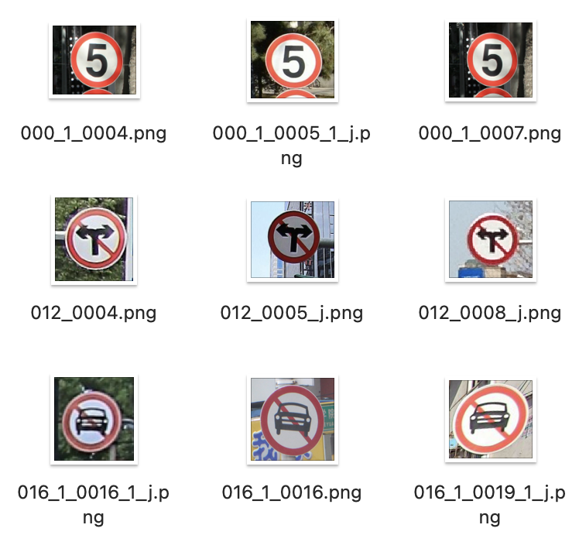
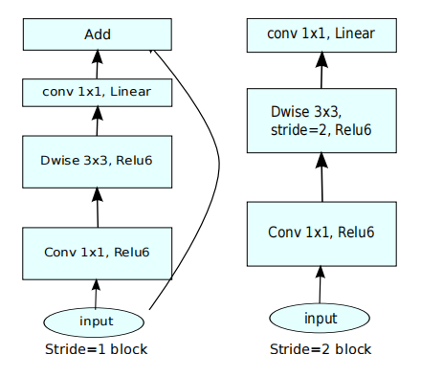
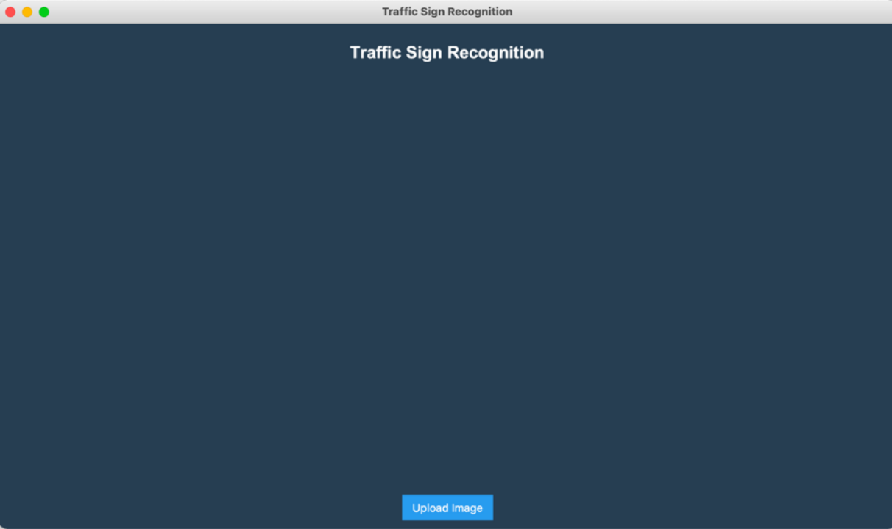
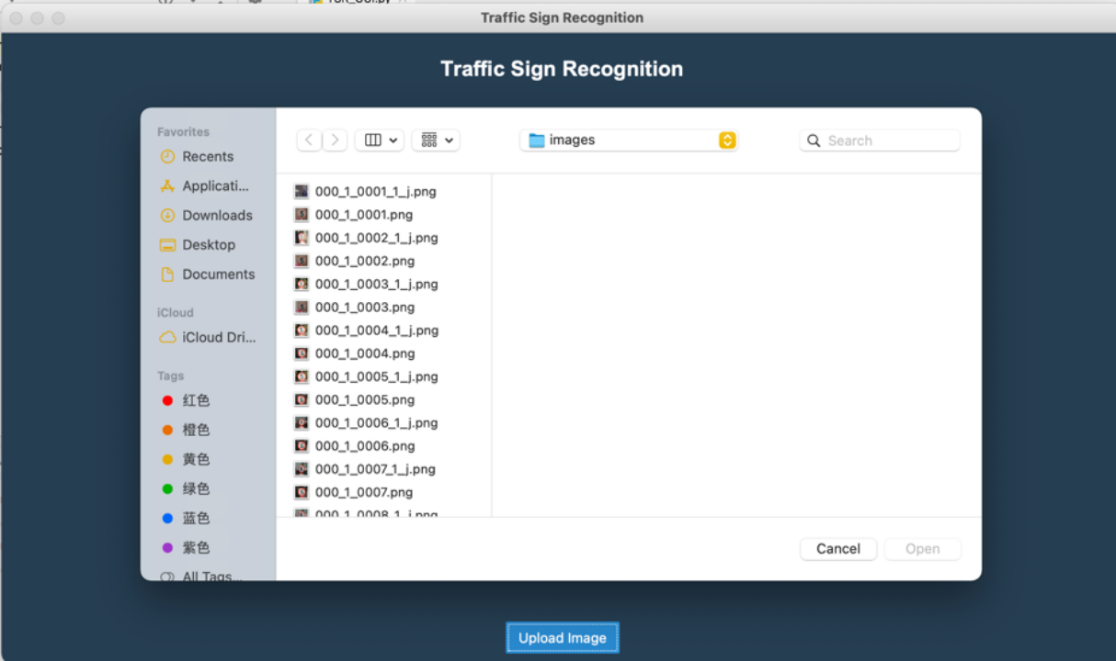
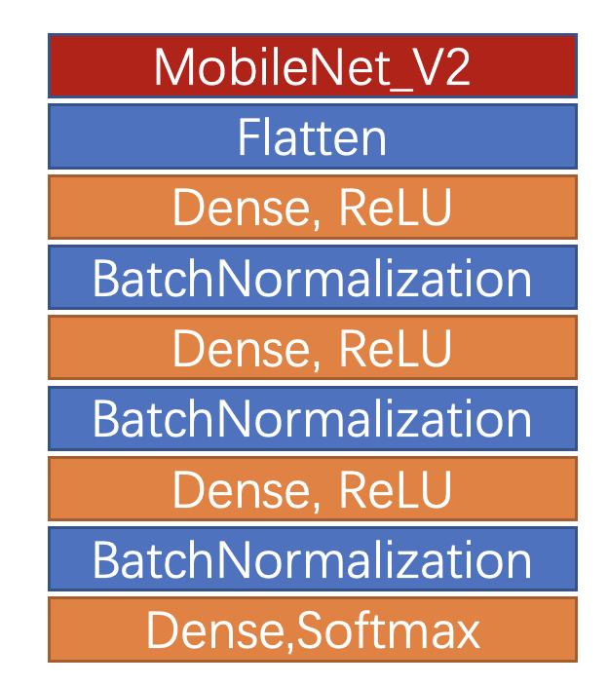
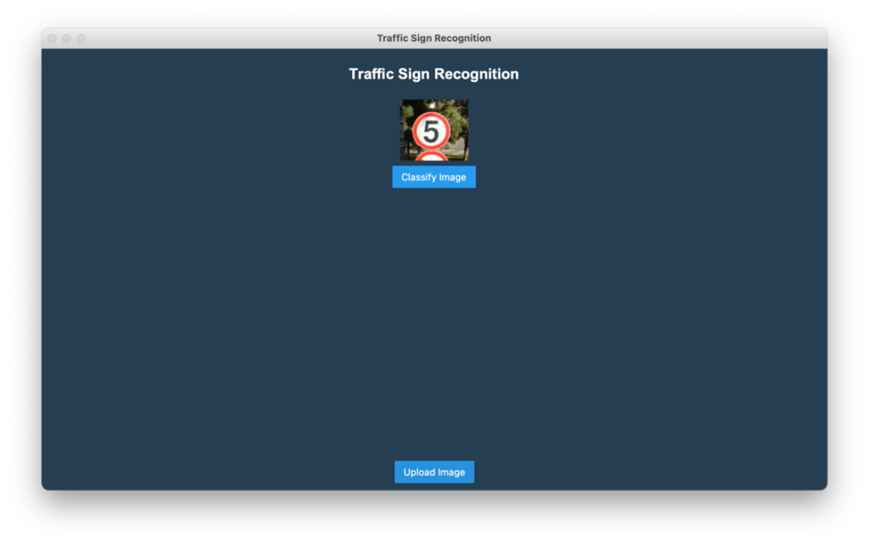
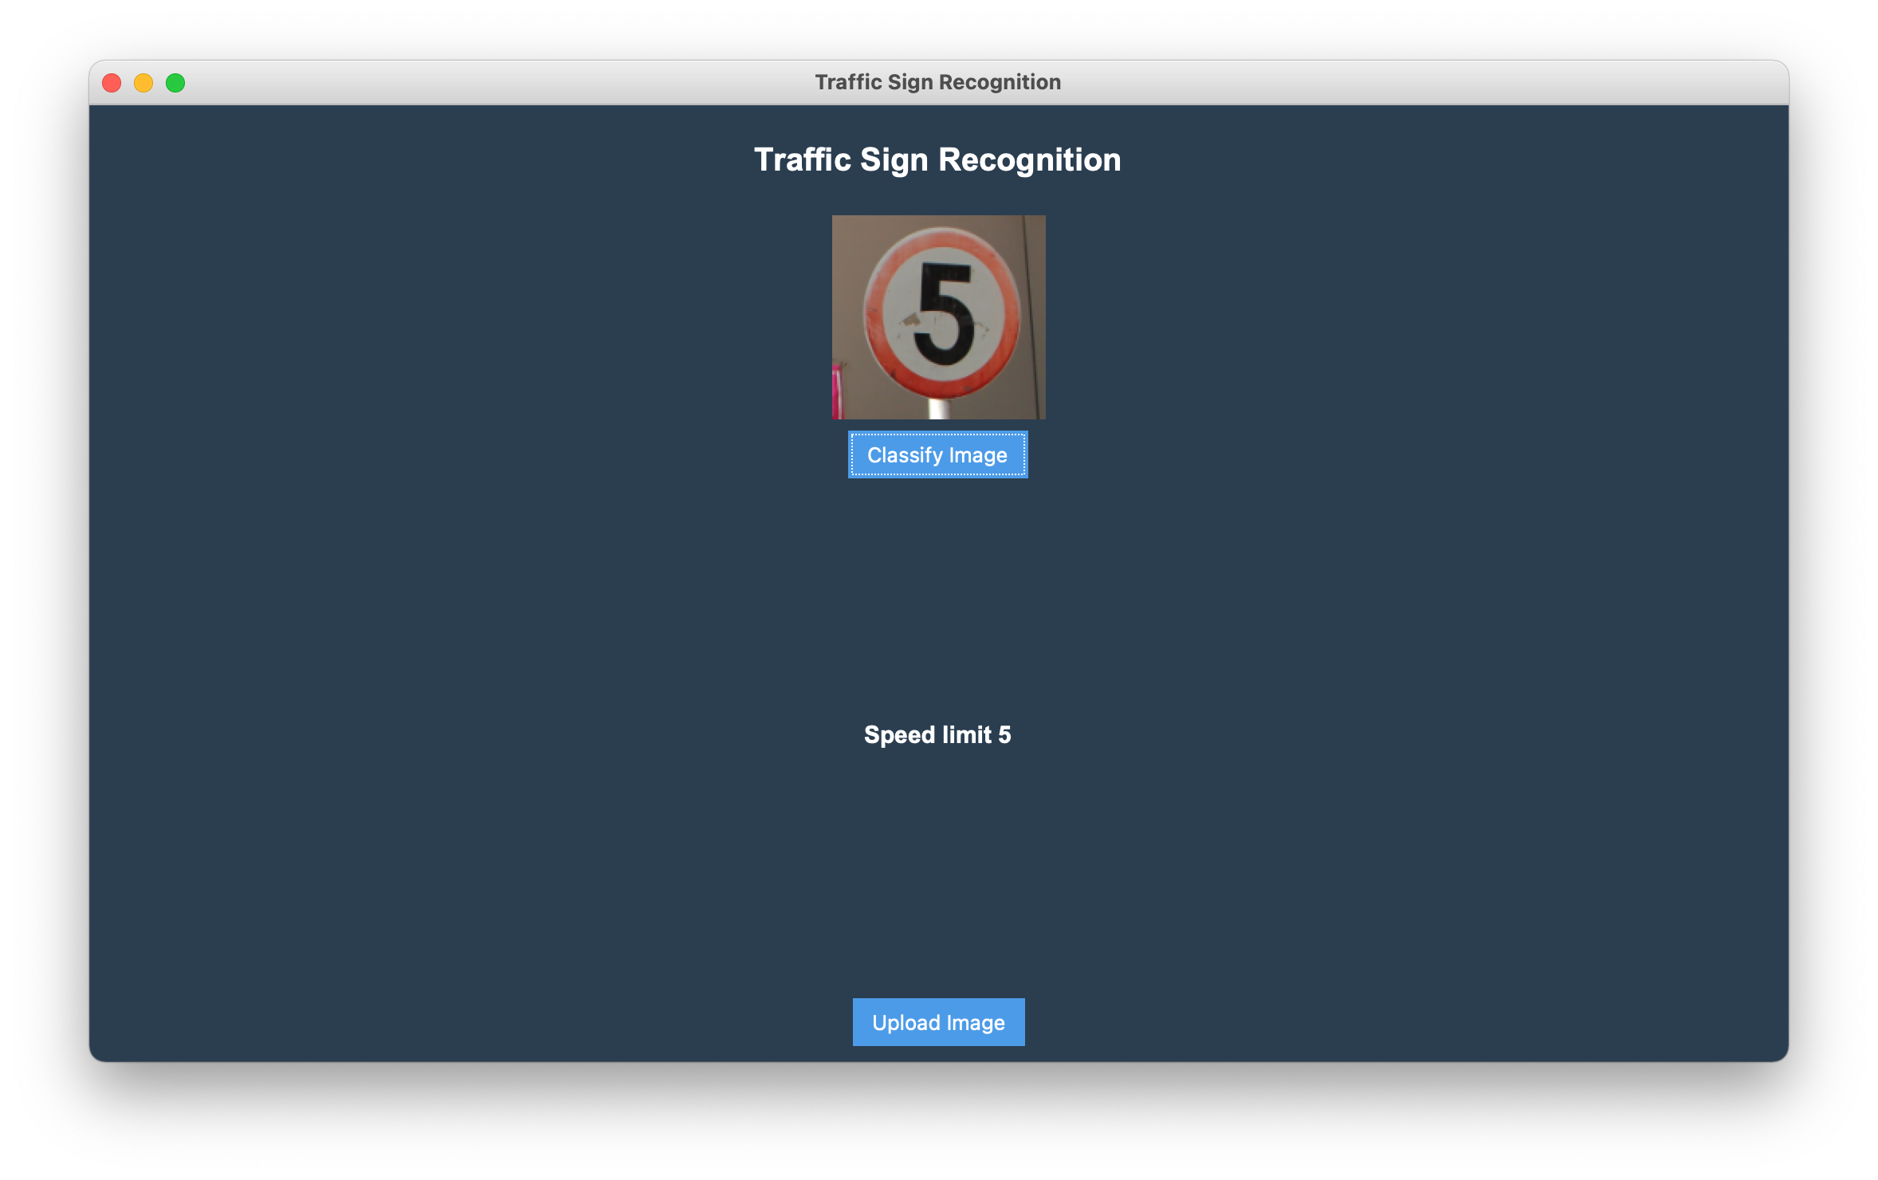
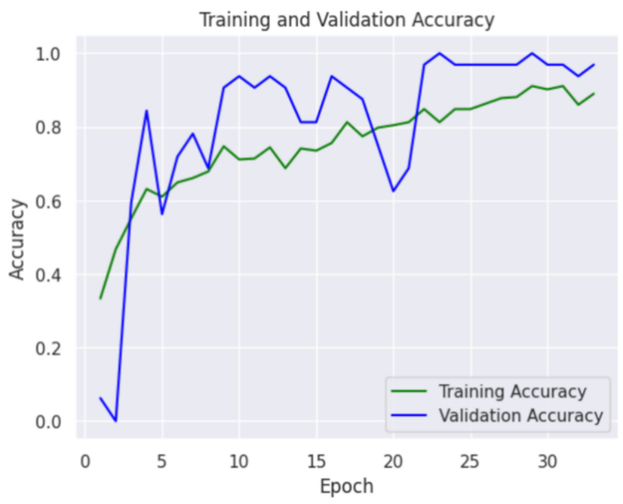
Haley
A Convolutional Neural Network Approach for the Recognition of Traffic Signs
Department of Software Engineering, Oxford Brooks University, Chengdu University of Technology
Supervised by Dr. Happy Monday
Abstract
Driverless car has been an increasing popular topic nowadays [1]. Therefore, the traffic signs recognition system which enables the automatically identification of traffic signs, also generates major discussion. And the deep learning technology, convolutional neural networks is able to identify traffic signs. This article is to explore the process to generate one lightweight CNN model MobileNetsV2 to identify traffic signs from Chinese Traffic Signs datasets, and design the Graphical User Interface for the model.
Introduction
Figure
1. Dataset
Human error made in traffic sign misidentification has always been a risk when driving [3]. However, traffic sign recognition is of great help since it is able to remind drivers of the signs, and automobile as well. The aim for the development of traffic sign recognition system is to save lives and mitigate traffic accident as well as to improve accuracy of traffic sign recognition system. The dataset adopted for the system is Chinese Traffic Signs. The image is in Figure 1.
Methodology
Dataset Preprocessing
In order to reduce the work of computation, the core deep learning model that this project focuses on is MobileNetV2 [1]. It is a convolutional neural network model that aims to achieve a good performance on mobile devices [2]. Moreover, Keras API was adopted for the project, playing the role of helping to build layers and model. As for the data processing, the approach is Keras image data generator. It generates batches which contains the data of tensor images and help loop over the data in batches. The software adopted for coding the model is JUPYTER notebook and the program language is Python and PyCharm is used to code GUI of the model. The hardware adopted to implement the code is Intel Xeon Cascade Lake.
Figure 2. Model Flow Chart
Dataset
Augmentation
MobileznetV2 Model Training
Attached Layer Model Training
Model Evaluation
Model Design
GUI Design
The adopted Python framework to complete GUI is Tkinter, a standard Python interface to the GUI toolkit. The purpose of designing the GUI is to demonstrate more visually the model‘s ability to identify traffic signs and to improve the completion of the project. Figure 5 presents the GUI images.
Figure 3 MobileNetV2 [1]
Figure 4 Model Architecture
Figure 5 GUI of the model
Result and Discussion
Figure 5 Table of Training and Validation Accuracy
The accuracy and speed of the recognition result is very important, since the driver needs fast judgement , and any error will cause unpredictable consequences. Therefore, this project adopted MobileNetV2 as the core networks. This model has the advantage of reduced computation but slight decrease in accuracy. Lastly, the model achieves the training accuracy of 88.10% and the validation accuracy of 93.75%.
Reference
[1] Andrew G. Howard, Menglong Zhu, Bo Chen, Dmitry Kalenichenko, Weijun Wang, Tobias Weyand, Marco Andreetto, and Hartwig Adam. Mobilenets: Effificient convolutional neural networks for mobile vision applications. CoRR, abs/1704.04861. 2017.
[2] Sandler, M. Howard, A. Zhu, M. Zhmoginov, A, and Chen, L. MobileNetV2: Inverted Residuals and Linear Bottlenecks, The IEEE Conference on Computer Vision and Pattern Recognition (CVPR), 2018, pp. 4510-4520.
[3] Hoanh, N. (2020) ‘Fast Traffic Sign Detection Approach Based on Lightweight Network and Multilayer Proposal Network’. Sensor Physical Interpretation, Signal and Artificial Intelligence Processing, 2020(6), pp.13, doi: https://doi.org/10.1155/2020/8844348
[4] Z. Wang, J. Wang, Y. Li and S. Wang (2022), "Traffic Sign Recognition With Lightweight Two-Stage Model in Complex Scenes," in IEEE Transactions on Intelligent Transportation Systems, 23(2), pp. 1121-1131, doi: 10.1109/TITS.2020.3020556.
[5] A. Benhamida, A. R. Várkonyi-Kóczy and M. Kozlovszky, "Traffic Signs Recognition in a mobile-based application using TensorFlow and Transfer Learning technics," 2020 IEEE 15th International Conference of System of Systems Engineering (SoSE), Budapest, Hungary, 2020, pp. 000537-000542, doi: 10.1109/SoSE50414.2020.9130519.

